Slide 1
OSS contributions
Code contribution Vs Non-code contributions – by Swetha Jayapathy

Slide 2
Research problem
Non-code contributions are given less recognition than code contributions in OSS communities though they play a significant role in the evolution of open source projects.

Slide 3
Research Questions
What is the frequency of code and non-code contributions in OSS projects over the past 5 years?
What are the components of non-code contributions and what are the key non-code contributions which impact OSS?
How does gender have an effect on the type of contribution being made in OSS projects?

Slide 4
Survey Results
27 people participated in the survey and around 7 of them have not contributed to OSS
70% responded Code contribution as their major type of contribution.
75% people agree that non-code contribution is as important as code contribution.
Major non-code contributions resulted in contributions such as comments, code review, testing & issues.

Slide 5
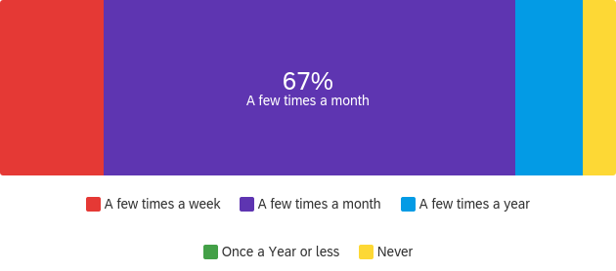
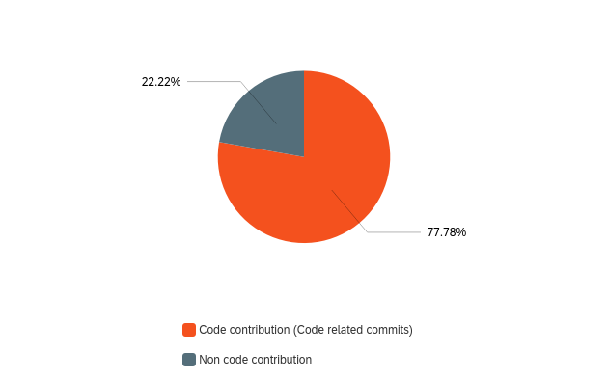
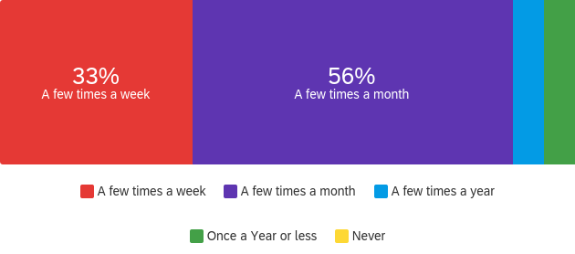
RQ1 - What is the frequency of code and non-code contributions in OSS projects over the past 5 years?
Frequency of Code contribution
Frequency of Non-code contribution
Participant’s major contribution

Slide 6
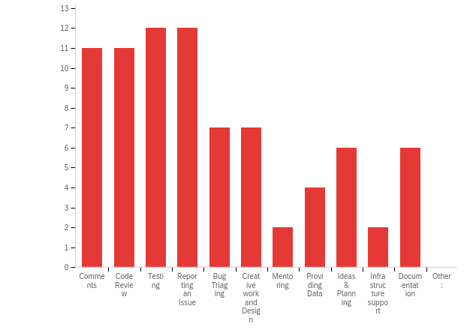
RQ2 - What are the components of non-code contributions and what are the key non-code contributions which impact OSS?

Slide 7
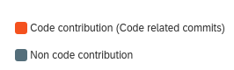
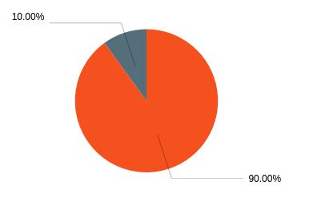
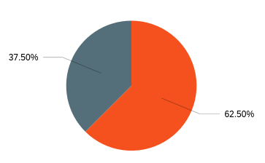
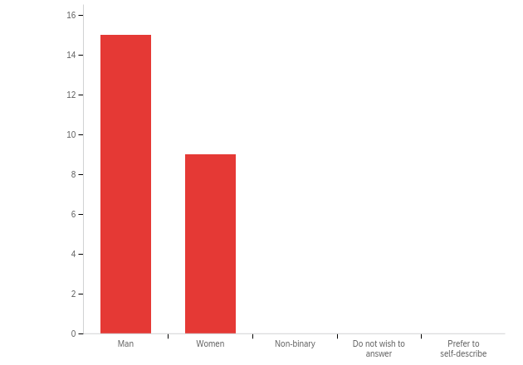
RQ3 - How does gender have an effect on the type of contribution being made in OSS projects?
Men
Women
Number of Men & Women participated

Slide 8
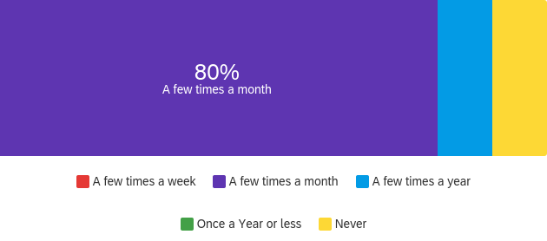
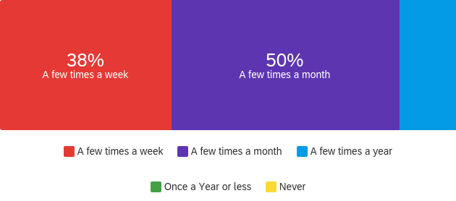
Code Contributions
Men
Women

Slide 9
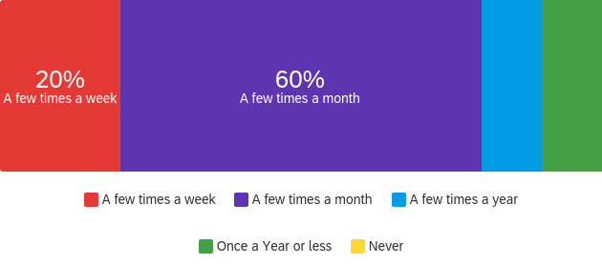
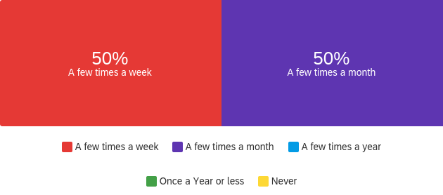
Non-code Contributions
Men
Women

Slide 10
THANK YOU

